Slide 1
Big Data with Hadoop
H1-B Case Study
Submitted by :-
Anandachar B.S

Slide 2
Big Data
'Big Data' is also a data but with a huge size. 'Big Data' is a term used to describe collection of data that is huge in size and yet growing exponentially with
It is a collection of large datasets that cannot be processed using traditional computing techniques.
Normally we work on data of size MB(WordDoc ,Excel) or maximum GB(Movies, Codes) but data in Peta bytes i.e. 10^15 byte size is called Big Data
Main Sources of Big Data - Social networking sites, E-commerce sites, Weather Station, Telecom company, Share Market, Search Engine Data.
The data will be of three types - Structured data, Semi Structured data, Unstructured data.
The 5 v’s of Big Data are – Velocity, Variety, Volume, Veracity, Value.

Slide 3
Hadoop
Hadoop is an open source framework, that supports the processing of large data sets in a distributed and computing environment.
Hadoop consists of MapReduce, the Hadoop distributed file system (HDFS) and a number of related projects such as Apache Hive, Hbase,Pig.
MapReduce and Hadoop distributed file system (HDFS) are the main component of Hadoop.

Slide 4
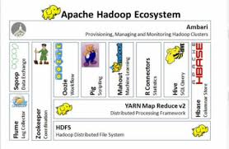
Hadoop Ecosystem

Slide 5
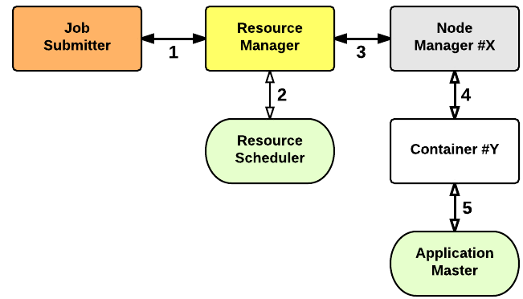
Yarn

Slide 6
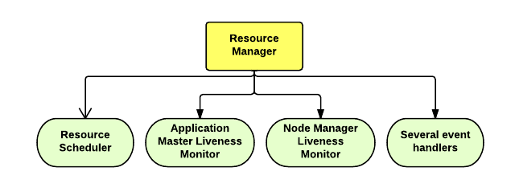
Resource Manager

Slide 7
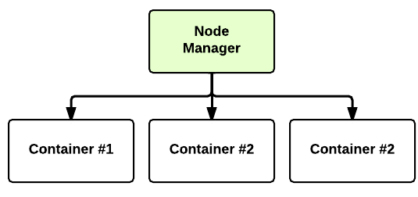
Node Manager

Slide 8
Hadoop Distributed File System
Assumes Commodity Hardware
--Files are replicated to handle hardware failure.
--Detect failures and recover from them.
Single Namespace for entire cluster
Data Coherency
--Write-once-read-many access mode.
Very Large Distributed File System
--10K nodes, 100 million files, 10PB.
--Client can only append to existing files.
Files are broken up into blocks
--Typically 64MB block size.
--Each block replicated on multiple Datanodes.
Intelligent Client
--Client can find location of blocks.
--Client accesses data directly from Datanodes.

Slide 9
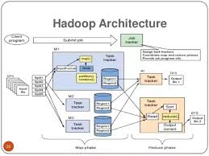
HDFS Architecture

Slide 10
Hadoop Distributed File System (HDFS) stores the application data and file system metadata separately on dedicated servers.
Namenode and Datanode are the two critical components of the Hadoop HDFS architecture.
Application data is stored on servers referred to as Datanodes and file system metadata is stored on servers referred to as Namenode.
HDFS replicates the file content on multiple Datanodes based on the replication factor to ensure reliability of data.
The Namenode and Datanode communicate with each other using TCP based protocols.

Slide 11
Namenode
is the centerpiece of HDFS. Namenode is also known as the Master
Namenode only stores the metadata of HDFS – the directory tree of all files in the file system, and tracks the files across the cluster.
Namenode does not store the actual data or the dataset. The data itself is actually stored in the Datanodes. Namenode is a single point of failure in Hadoop cluster.
Data Node
Datanode is responsible for storing the actual data in HDFS. Datanode is also known as the Slave
Namenode and Datanode are in constant communication.When a Datanode starts up it announce itself to the Namenode along with the list of blocks it is responsible for.
When a Datanode is down, it does not affect the availability of data or the cluster. Namenode will arrange for replication for the blocks managed by the Datanode that is not available.
Datanode is usually configured with a lot of hard disk space. Because the actual data is stored in the Datanode.

Slide 12
Map Reduce
*MapReduce is a programming model suitable for processing of huge data. Hadoop is capable of running MapReduce programs written in various languages: Java, Ruby, Python, and C++. MapReduce programs are parallel in nature, thus are very useful for performing large-scale data analysis using multiple machines in the cluster
MapReduce programs work in two phases:
*Map phase: This is very first phase in the execution of map-reduce program. In this phase data in each split is passed to a mapping function to produce output values.
* Reduce phase: In this phase Reduce collects and combines the output from Map task and fetches it. In short, this phase summarizes the complete dataset.

Slide 13
Hive
->Developed at Facebook
->Used for majority of Facebook jobs
->“Relational database” built on Hadoop
*Maintains list of table schemas
*SQL-like query language (HiveQL)
*Can call Hadoop Streaming scripts from HiveQL
*Supports table partitioning, clustering, complex data types, some optimizations

Slide 14
Pig
->Started at Yahoo! Research
->Now runs about 30% of Yahoo!’s jobs
->Features
*Expresses sequences of Map Reduce jobs
*Data model: nested “bags” of items
*Provides relational (SQL) operators (JOIN, GROUP BY, etc.)
*Easy to plug in Java functions

Slide 15
H1B-VISA PROJECT
:-> The H1B visa program is the primary method for employers to recruit & hire International professionals and International students to work in the USA.
:-> The H1B program allows workers in specialty occupations to work in the US for up to a total of six (6) years.
:-> One of the things that makes the H1B so desirable is that, unlike many other nonimmigrant visa categories, it is a "dual intent" visa.
:-> This means that a visa will not be denied simply because a person has intentions to become a permanent resident.
:-> The employer needs to verify that the H1B visa worker is being paid the prevailing wage for the work being performed and that employment of a foreign worker is not harming conditions for US workers.

Slide 16
T
Flow of project
--->The dataset description is as follows:
---> The columns in the dataset include:
---> CASE_STATUS: Status associated with the last significant event or decision. Valid values include “Certified,” “Certified-Withdrawn,” Denied,” and “Withdrawn”.
---> Certified: Employer filed the LCA, which was approved by DOL
---> Certified Withdrawn: LCA was approved but later withdrawn by employer
---> Withdrawn: LCA was withdrawn by employer before approval
---> Denied: LCA was denied by DOL
---> EMPLOYER_NAME: Name of employer submitting labour condition application.

Slide 17
SOC_NAME: the Occupational name associated with the SOC_CODE. SOC_CODE is the occupational code associated with the job being requested for temporary labour condition, as classified by the Standard Occupational Classification (SOC) System.
JOB_TITLE: Title of the job
FULL_TIME_POSITION: Y = Full Time Position; N = Part Time Position
PREVAILING_WAGE: Prevailing Wage for the job being requested for temporary labour condition. The wage is listed at annual scale in USD. The prevailing wage for a job position is defined as the average wage paid to similarly employed workers in the requested occupation in the area of intended employment. The prevailing wage is based on the employer’s minimum requirements for the position.
YEAR: Year in which the H1B visa petition was filed
WORKSITE: City and State information of the foreign worker’s intended area of employment
lon: longitude of the Worksite
lat: latitude of the Worksite

Slide 18
THANK YOU

